Slide 1
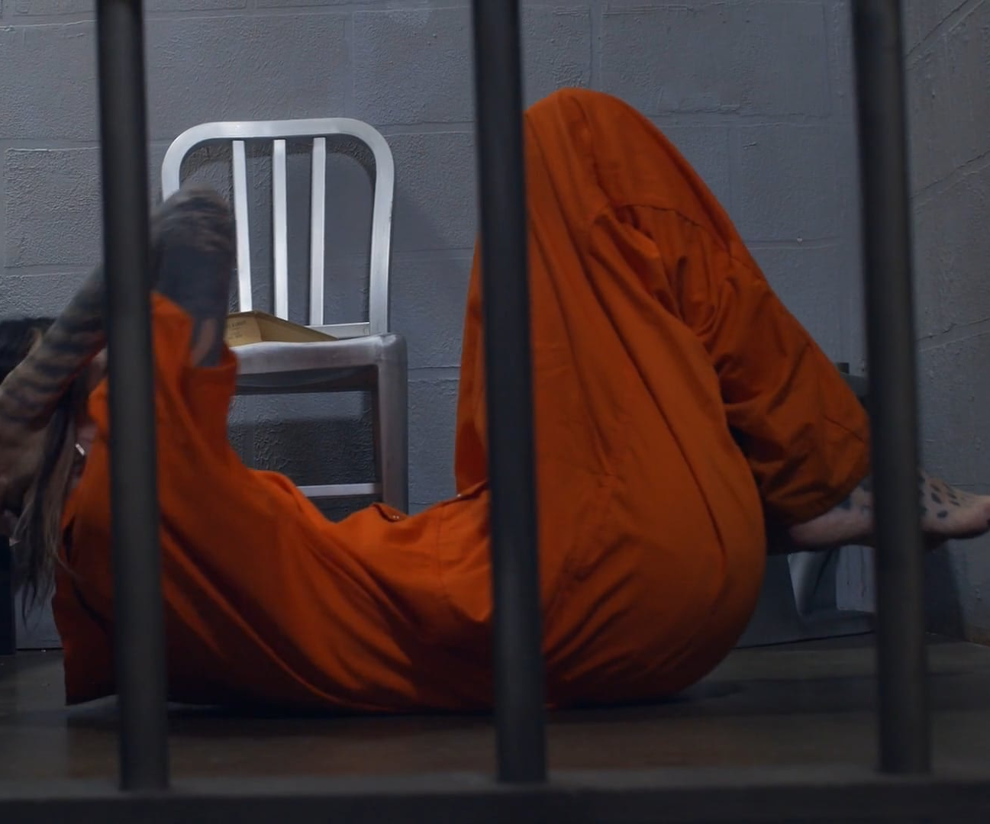
Unspoken Words: Understanding Death Row Inmates through Text Mining

Slide 2
AGENDA
Introduction
Introduction to Dataset
Unsupervised Learning
Recommendations & Conclusion
Our Team
Supervised Learning

Slide 3
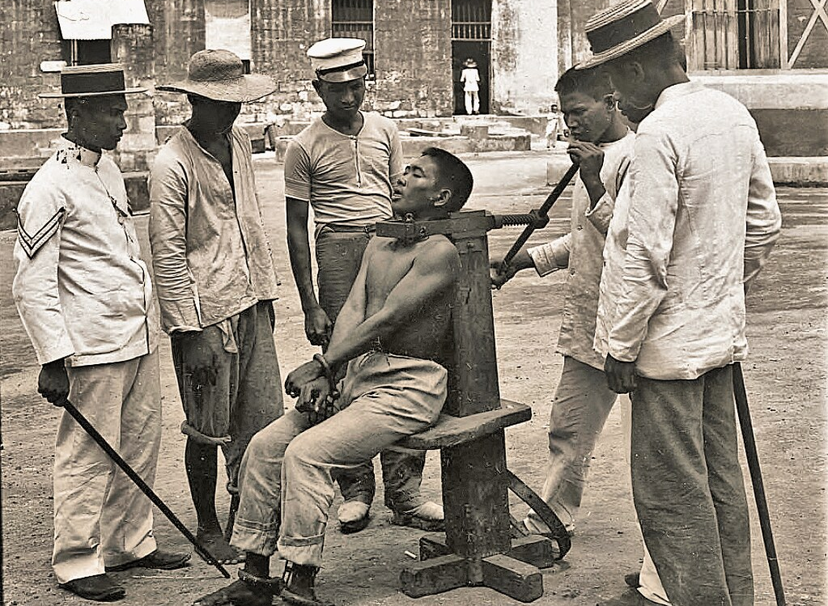

INTRODUCTION
Introduction to the capital punishment and its status in Texas.
This project focuses on understanding mental condition prior to execution of death row inmates based on demographic factors and geographic location .
Notes:
Good afternoon, everyone, we are here to present on last words of death row inmates. Capital punishment, also known as the death penalty, is a highly contentious topic, and its legal status varies across different states in the United States. Texas is a state that has not outlawed capital punishment and has carried out the highest number of executions since 1976 compared to other states where it is still legal (Source). In our project, we will focus on exploring the impact of demographic factors and geographic location, specifically within the context of Texas, on the last words of death row inmates. This project aims to use text mining techniques to explore patterns and themes in the final statements of these inmates. They provide a unique window into the minds of individuals who are facing the end of their lives.

Slide 4
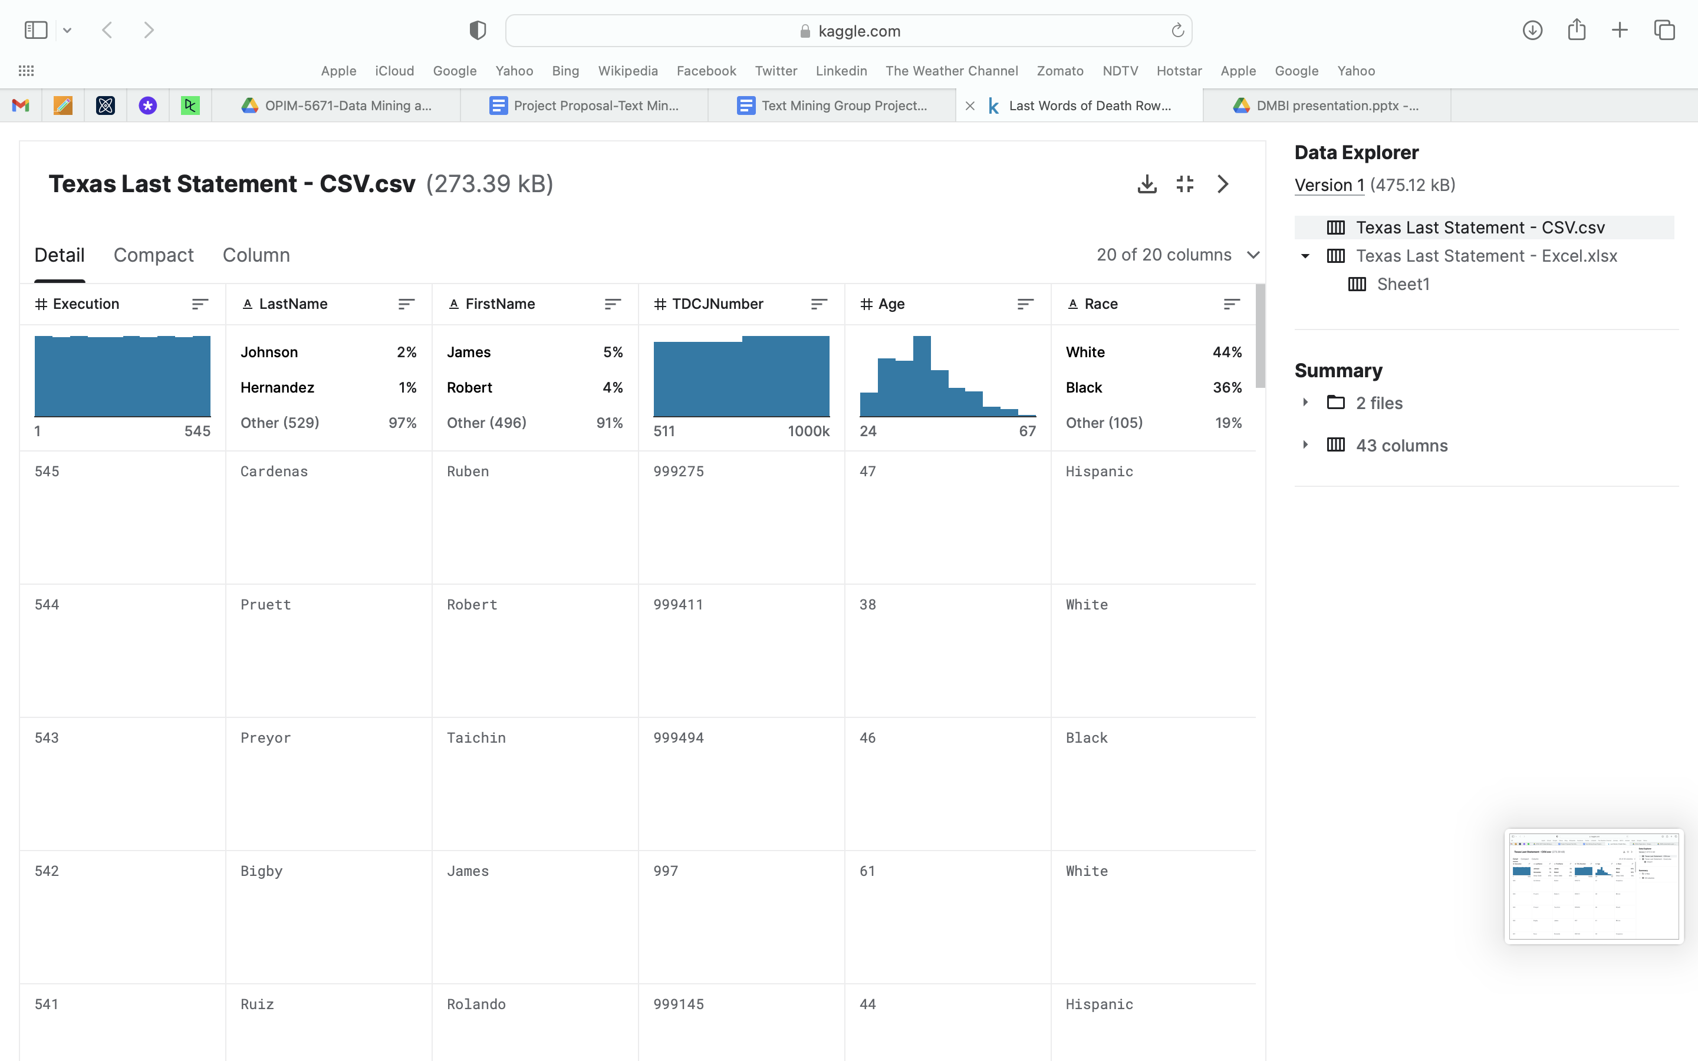
DATASET
Last Words of Death Row Inmates Kaggle
Our dataset was obtained from Kaggle, which collected information from the website of the Texas Department of Criminal Justice.
The Texas Department of Criminal Justice executed 582 prisoners using the death penalty between the years 1982 and 2023.
The dataset comprises 21 variables, and we will explore various variable combinations to determine which columns provide the most valuable data for our project.

Slide 5
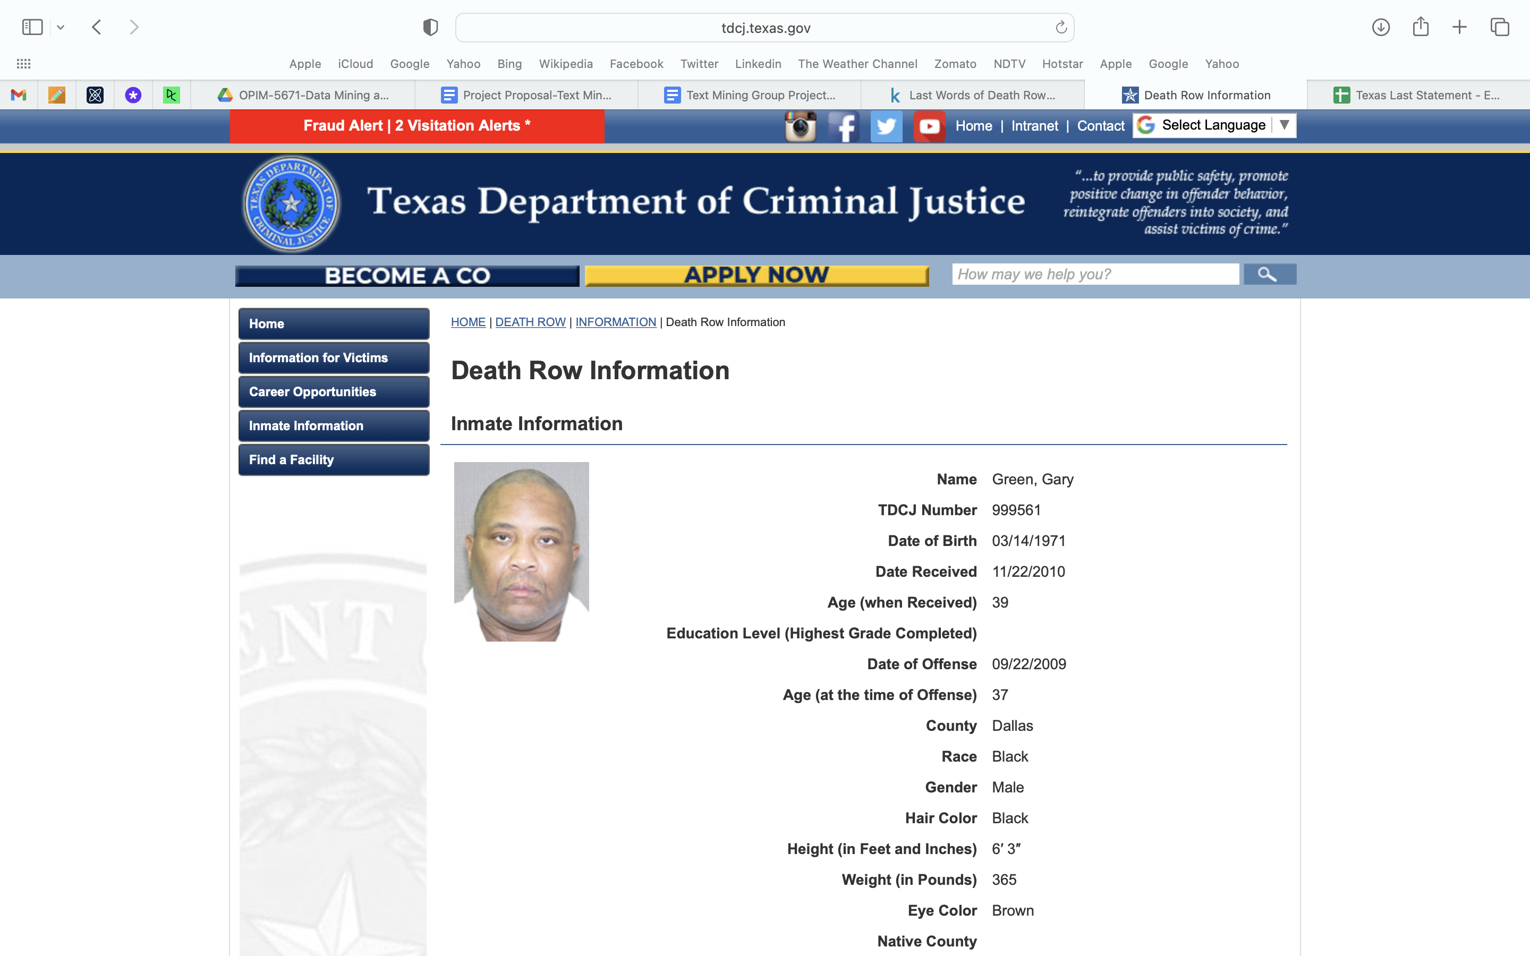
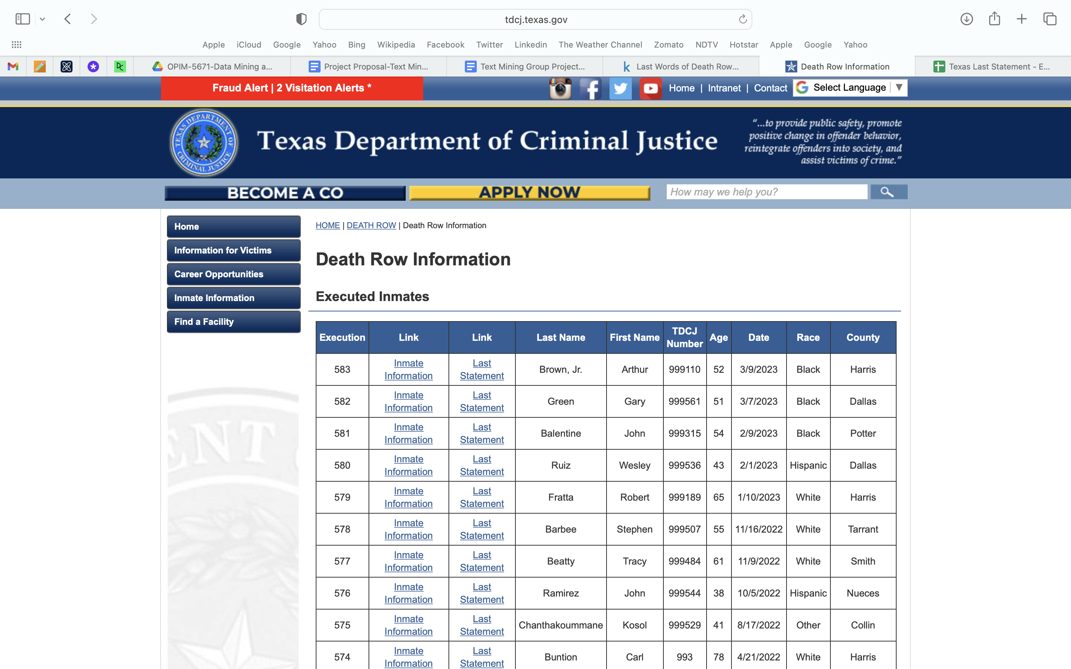
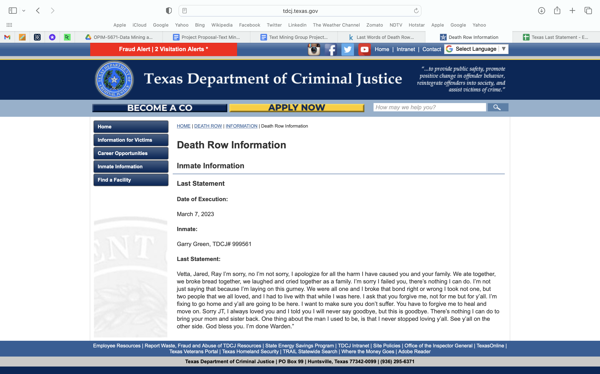
DATASET
Death Row Executed Offenders

Slide 6
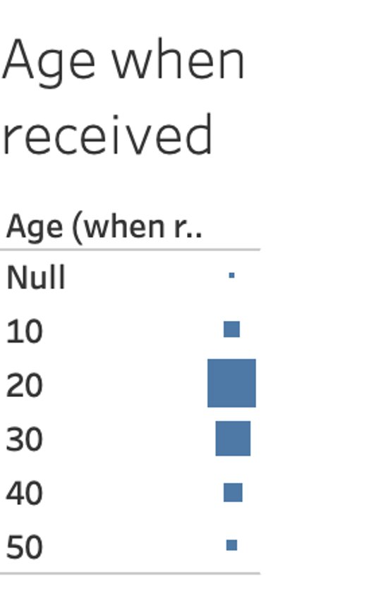
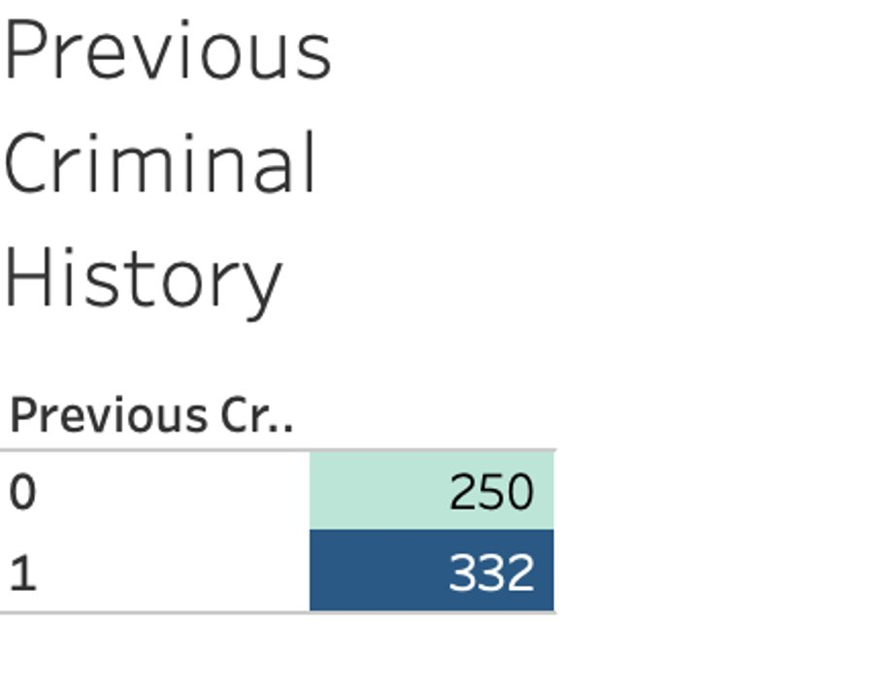
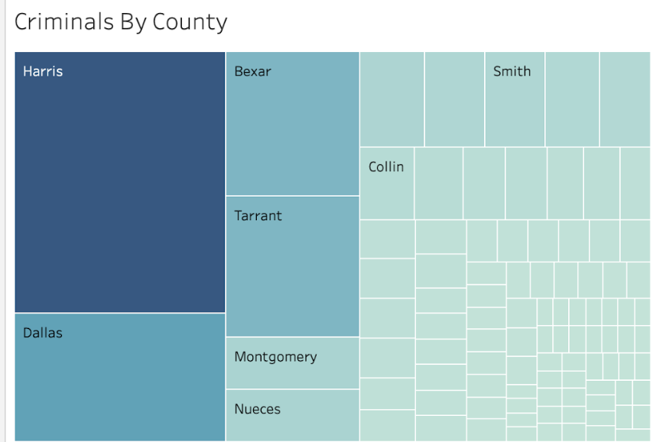
DATASET
Notes:
Population density: Both Harris County and Dallas County are among the most populous counties in Texas, with high population densities. As population increases, crime rates may also rise due to factors such as increased competition for resources, higher poverty rates, and social inequality.
Urbanization: Harris County and Dallas County are urban areas with large cities like Houston and Dallas, respectively. Urban areas often have higher crime rates compared to rural areas due to various factors such as higher population density, increased availability of targets for crime (such as businesses and residential properties), and more opportunities for criminal activities.
Socioeconomic factors: Higher crime rates in Harris County and Dallas County may also be influenced by socioeconomic factors such as poverty, unemployment, and lack of access to education and economic opportunities. Areas with higher poverty rates and economic disparities may experience higher crime rates as individuals may turn to crime as a means of survival or due to limited opportunities for legal employment.
Demographic factors: Demographic factors such as age, race, and ethnicity can also impact crime rates. Harris County and Dallas County have diverse populations with various demographic factors that can influence crime rates. For example, areas with higher concentrations of young people, who may be more prone to engage in criminal activities, may experience higher crime rates.
Criminal justice policies and enforcement: Differences in criminal justice policies, law enforcement practices, and resources allocated for crime prevention and law enforcement may also impact crime rates in Harris County and Dallas County. For example, variations in policing strategies, prosecution practices, and incarceration rates can affect crime rates in different areas.
It's important to note that crime rates are complex phenomena influenced by a multitude of factors, and it's challenging to pinpoint a single cause for higher crime rates in specific counties or areas. A comprehensive analysis would require a more in-depth study taking into consideration various factors and their interactions to fully understand the dynamics of crime in Harris County, Dallas County, or any other location.

Slide 7

Data prE-PROCESSING
MISSING VALUES: There were very less missing values in the dataset. Some rows contained NA values which were deleted.
FEATURE ENGINEERING:
A) Age range
B) County
C) Previous crime
This Photo by Unknown Author is licensed under CC BY-SA

Slide 8
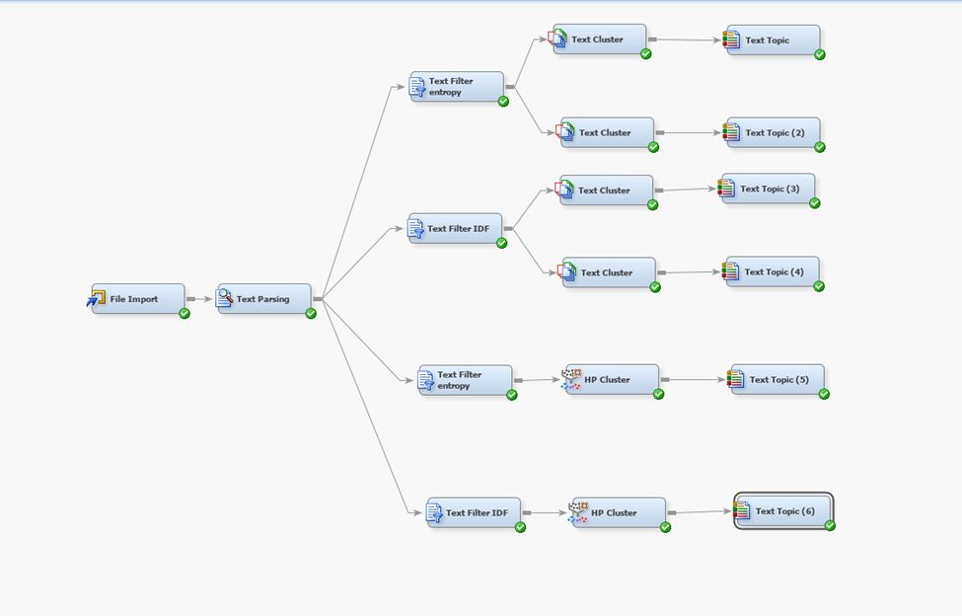
Unsupervised learning
Diagram

Slide 9
Repeating words
3 Clusters | Docs | Percentage of Docs | Document Cutoff | Term Cutoff | Number of Terms
sorry, forgive, family, hope, peace | 174 | 43.9% | 0.141 | 0.038 | 108
kill, keep, innocent, continue, people | 139 | 35.1% | 0.080 | 0.039 | 141
lord, name, heaven, father, evil | 83 | 20.9% | 0.094 | 0.037 | 108
5 Clusters | Docs | Percentage of Docs | Document Cutoff | Term Cutoff | Number of Terms
sorry, hope, peace, pain, forgive | 160 | 28.1% | 0.112 | 0.038 | 95
innocent, kill, people, make, state | 97 | 17.0% | 0.072 | 0.039 | 145
evil, art, heaven, kingdom, name | 28 | 4.9% | 0.078 | 0.037 | 89
strong, stay, love, keep | 141 | 24.8% | 0.107 | 0.037 | 90
Jesus, lord, christ, god, thank | 143 | 25.1% | 0.100 | 0.038 | 94

Slide 10
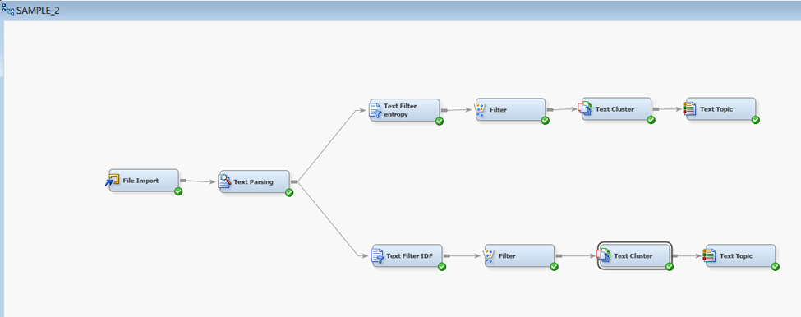
Combined VARIABLES MODEL

Slide 11
Combined output RESULTS
Combination of county Harris,
criminal history yes and age under 30​
Combination of county Harris, ​
criminal history no and age under 30​
Entropy | Percentage
Rate of remorse | 52.4%
Rate of non-remorse | 47.6%
Entropy | Percentage
Rate of remorse | 50.0%
Rate of non-remorse | 50.0%
Combination all counties, criminal history yes and age under 50
Combination of all counties, criminal history no and age over 50
Entropy | Percentage
Rate of remorse | 51.7%
Rate of non-remorse | 48.3%
Entropy | Percentage
Rate of remorse | 62.4%
Rate of non-remorse | 37.6%

Slide 12
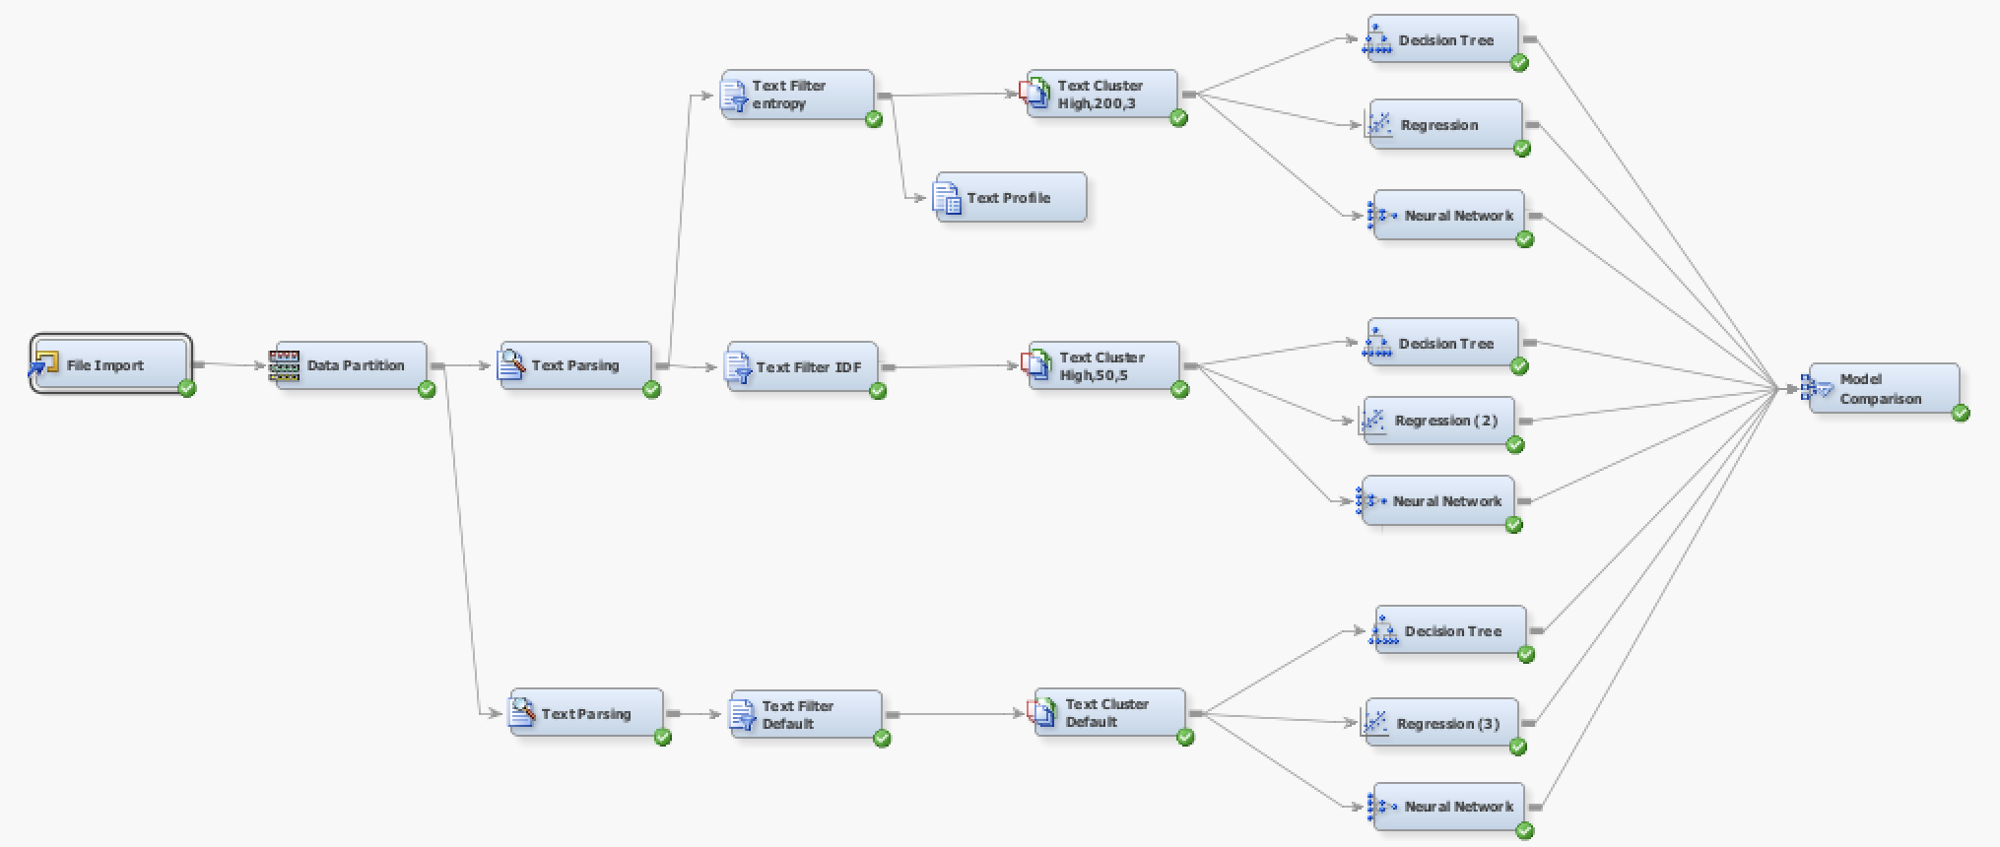
supervised learning
Diagram
Notes:
80:20 > DATASET IS SMALL 583 rows to understand the best model, 70:20:10 for test results

Slide 13
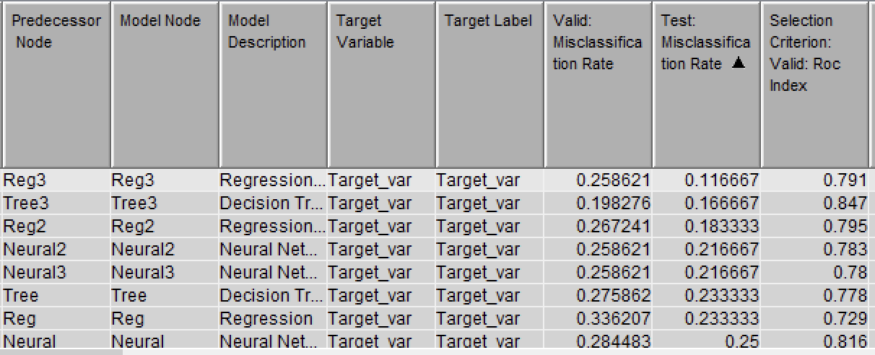
MODEL COMPARISON

Slide 14
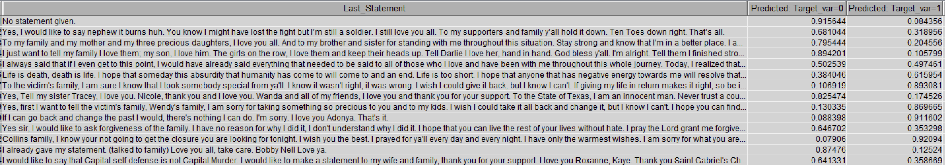
Test data prediction results
I already gave my statement. (talked to family) Love you all, take care. Bobby Nell Love ya.
0.87476
0.87476
if I can go back and change the past I would, there's nothing I can do. I'm sorry. I Love you Adonya. That's it.
0.911602

Slide 15
RECOMMENDATIONS & Conclusion
Consider the mental health of death row inmates
Re-examine the use of capital punishment
Provide support for families
Promote awareness and education
Notes:
Consider the mental health of death row inmates: It is important to carefully consider the mental health of death row inmates before their execution, and to provide appropriate support and resources to help them cope with their situation.
Re-examine the use of capital punishment: Given the complexities involved in the application of capital punishment, it is important to re-examine its use and consider alternative forms of punishment that may be more effective in promoting justice while protecting the rights and well-being of all individuals involved.
Provide support for families: The families of death row inmates also require support and resources to help them cope with the emotional and psychological toll of their loved one's situation.
Promote awareness and education: It is important to promote awareness and education about the ethical implications of capital punishment, and to encourage open and respectful dialogue about this complex issue in order to promote greater understanding and progress towards a more just and equitable society.
Moving forward, it will be important to continue exploring innovative approaches to data analysis and interpretation, in order to gain a more nuanced understanding of the factors that influence criminal behavior and attitudes towards punishment. By leveraging the power of data and technology, we can work towards a more just and equitable society, where all individuals are treated with fairness and compassion, regardless of their circumstances or background.

Slide 16

Thank you
This Photo by Unknown Author is licensed under CC BY-SA-NC

